Slide 1
History of the Texas Occupational Therapy Association (TOTA)
Esther Bell Kathlyn L. Reed
With contributions by Mary Hennigan

Slide 2
Early Years
Information is still being compiled –
First OTs employed Texas that can be documented are the reconstruction aides assigned to Fort Travis, San Antonio, in January, 1919.
First OT employed at a Texas operated facility is Martha E. Gilbert in 1925 at the Southwester Insane Asylum (now San Antonio State Hospital.

Slide 3
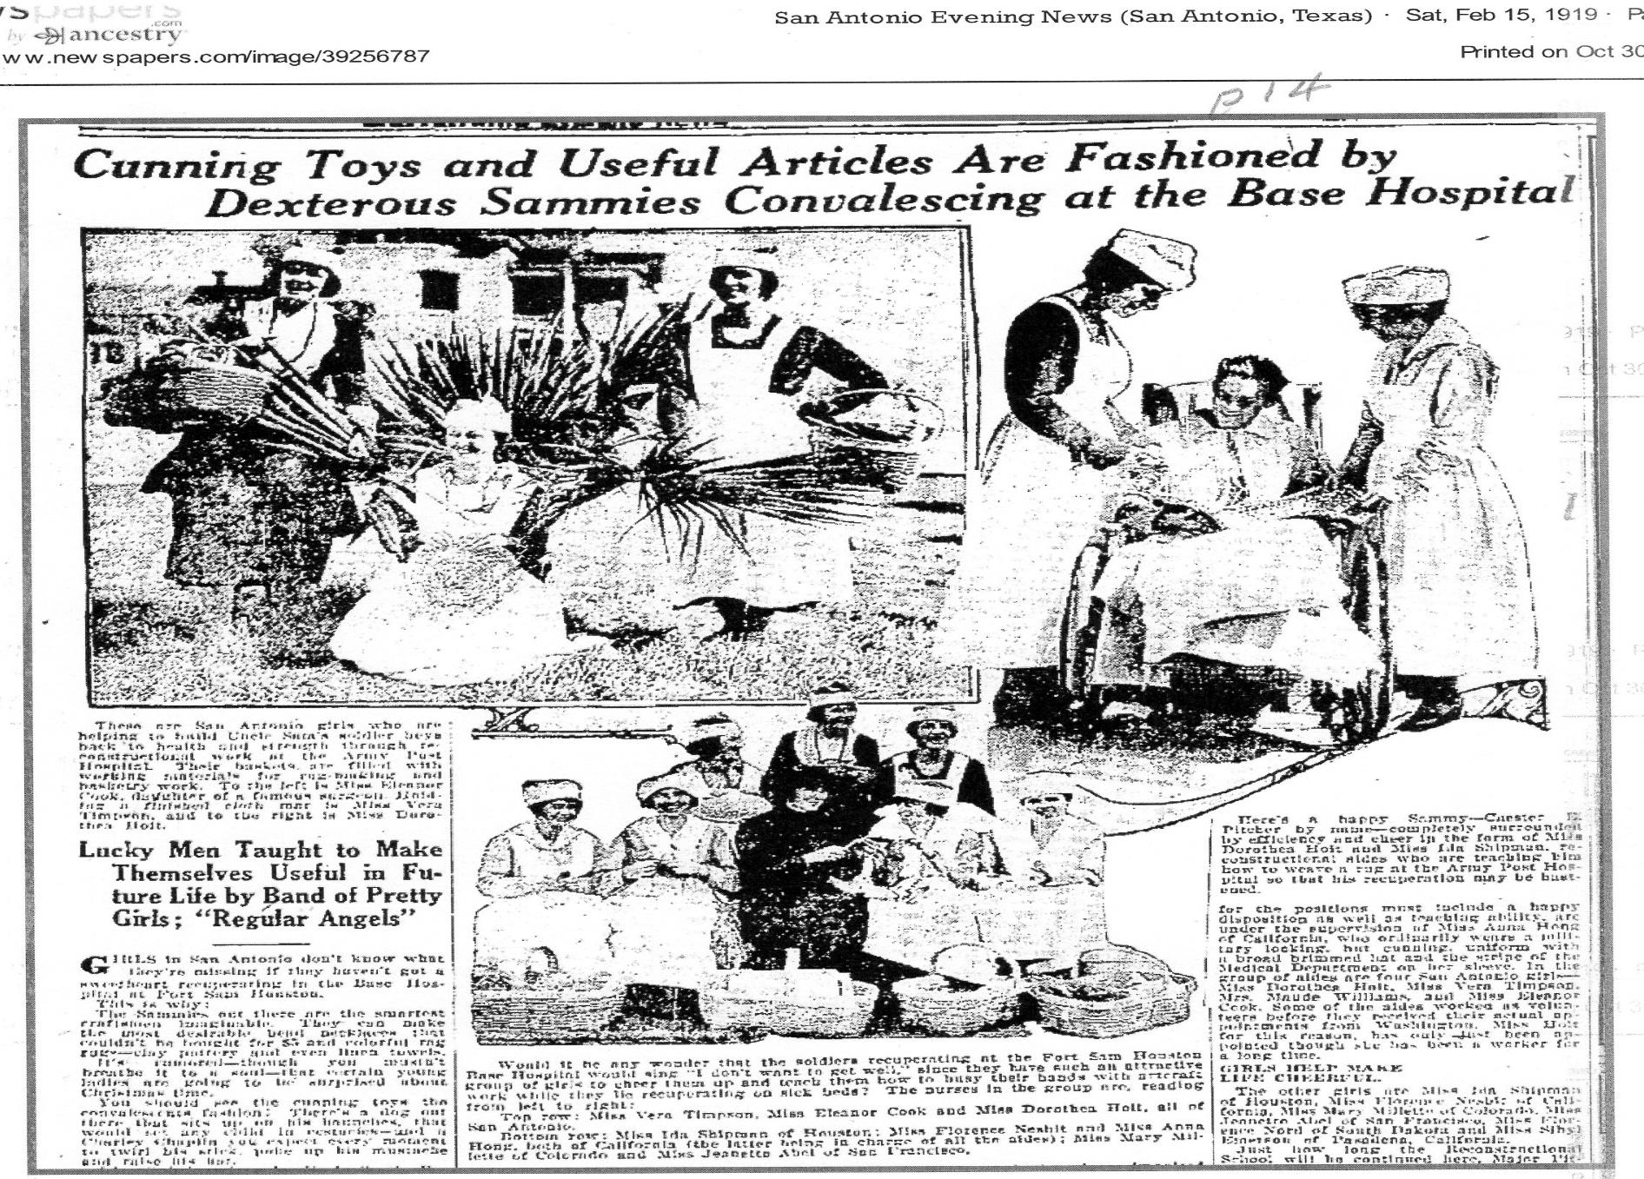
Reconstruction Aides at Camp Travis

Slide 4
Names in Article
Jeanette Abel: San Franciso
Eleanor Cook: San Antonio
Dorothea Holt: San Antonio
Anna Hong: California
Mary Millette: Colorado
Florence Nesbit: California
Ida Shipman: Houston
Vera Timpson: San Antonio

Slide 5
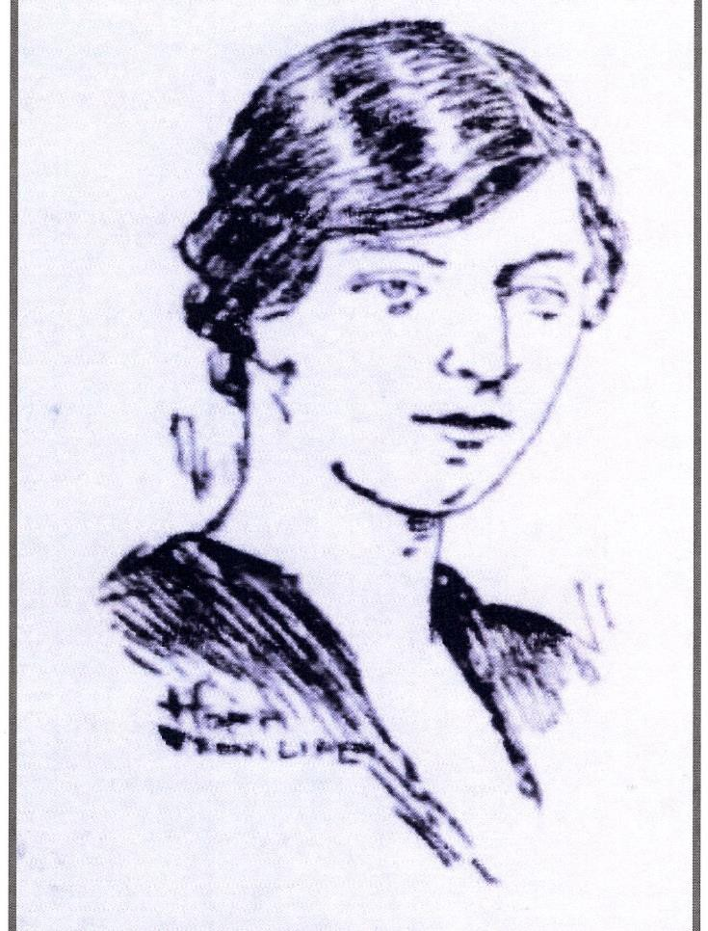
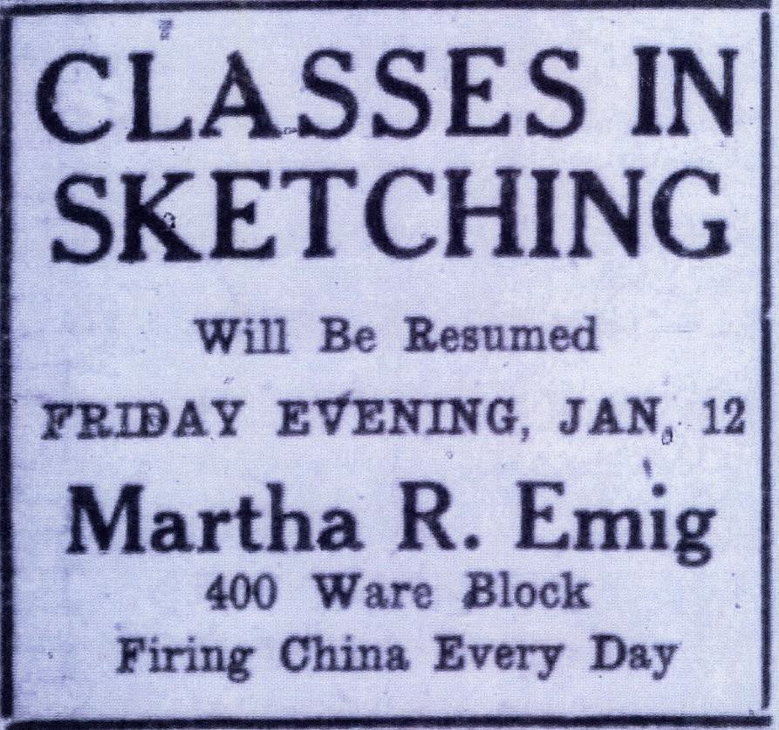
Reconstruction Aide: Camp Logan
Martha Roslin Emig

Slide 6
Reconstruction Aides Born in Texas
Mary (Mollie) Weldon Blake (Mrs. Rufus Burleson Pearce Sr.), (1890-1971). Born in Cuero (DeWitt County). Served in Coblen, Germany
Areat Leone (Honey) Huneycutt (Mrs. James Moore), (1900-1969). Born in Gatesville (Coryell County). Served in USA. Postwar served in VA Hospital in Legion (Kerrville)
Clyde McDowell Myres (William Myres) (1875- 1962). Born in Eagle Pass (Maverick County). Served in France and post war in Dallas
Mary Tom Osborne (1899-1964). Born in Walnut Springs (Ellis
county). Served at Fort Sam Houston

Slide 7
Reconstruction Aides born in Texas
Pearl Pauline (Polly) Parks (Mrs. McKenzie, Mrs. Laventure (1896-1964). Born in Beeville (Bee County). Service dates & location unknown.
Jean (Jeanie) Guthrie Polk (Mrs. Merritt Bishop), (1889-1969). Born in Bandera (Bandera County). Service dates & location unknown
Ida May Shipman (Mrs. C. LeRoy Childs, Mrs. Wesley Merritt), (188901990). Born in Galveston (Galveston County). Served at Fort Sam Houston, 1919- 1920

Slide 8
First Practitioners by TOTA District
Alamo South: Reconstruction aides at Camp Travis ,January, 1919, Alice Eads, Legion Hospital (VA Hospital, #93), 1922. Martha Ellen Gilbert, Southwestern Insane Asylum (San Antonio State Hospital), 1924
Capital Centex: Martha Gilbert, 1927, Marjorie (Margie) Woodward, 1928. Austin State Hospital
Great Plains West: Beatrice S. Manning Cooney, Wichita Falls State Hospital, 1937

Slide 9
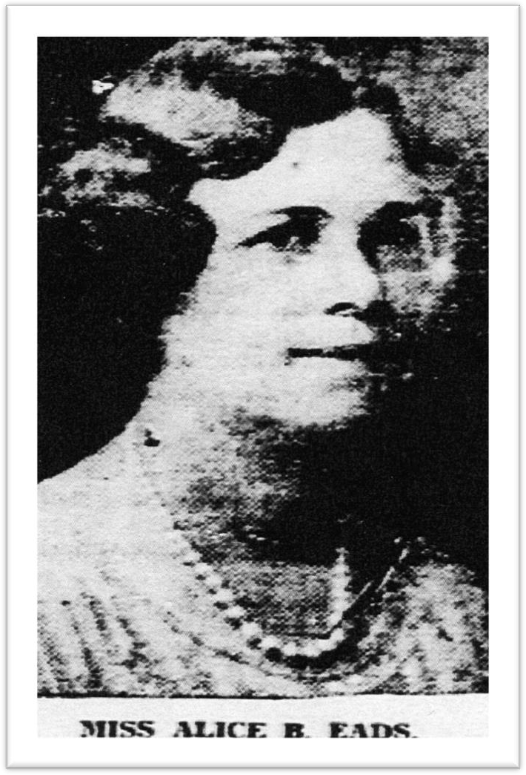
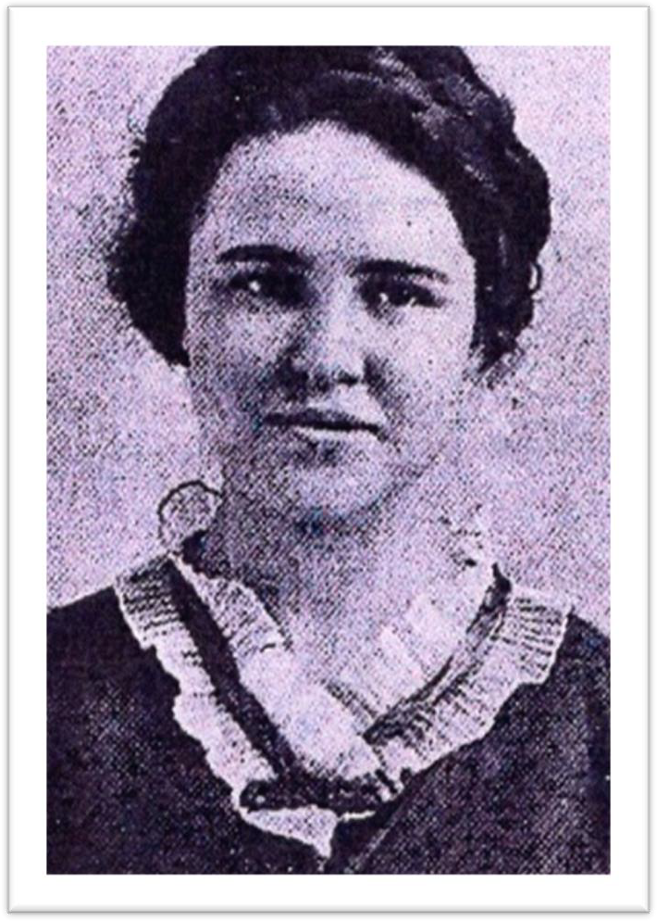
Early Practitioners
Martha Ellen Gilbert
Dallas Morning News, 9/2/1935

Slide 10
First Practitioners by TOTA District
Gulf Coast East: Martha Rosilin Emig. Camp Logan (Houston), 1920; Erma Nicholson, Methodist Hospital, about 1937
Rio Grande: Grace Holder Schafer, Salvation Army Rescue Home school, 1929
Trinity North: Margaret Dennis, 1924? Workshop for Physically Handicapped Women operated by the Junior League. Isabel M. Cameron (Rittenhouse), Scottish Rite Hospital (Junior League)

Slide 11
Early Meetings
Informal meetings of interested occupational therapists began in 1932 according to Pearl Jones Tenneyson.
“Organizing meeting” October 12, 1935, Driskell Hotel, Austin
Members present:
Jane Myers, Dallas
Marjorie Woodward, Austin
Olga Wheeler, Austin
Dean Crausby, Austin
Ada Tervin, Music Therapist, Austin
Dr. Charles W. Cather

Slide 12
Founding Meeting
July 5, 1936 Melrose Hotel, Dallas. “Founding meeting” (Minutes,
7/5/36)
Constitution and bylaws were enacted
Officers
President: Jane E. Myers, Scottish Rite Hospital, Dallas
VP: Margie E. Woodward, Austin State Hospital, Austin
Secretary/Treasure: Olga Wheeler, Baptist Hospital, Dallas
Board of Managers:
Alice B. Eads, Veterans Administration Facility #93, Legion
Mrs. Clyde McDowell Myres, Beverly Sanitarium, Dallas
Membership Committee:
Charlotte Dracup, Austin State Hospital
Irma Nickleson (Mrs. Thomas Nickleson), State Hospital for Feeble- Minded, Austin

Slide 13
Purposes of TOTA, 1936
Educate our medical profession and general public in the value of occupational therapy and the necessity of thoroughly trained therapists in each department.
Interest every member of our profession in establishing a high standard for every department in the state.
Register in our National Registry every therapist qualified to do so and stimulate those who do not qualify, to secure necessary training, that they may register.

Slide 14
Purposes Continued
Create in our membership a desire for greater and more diversified application of occupational therapy.
Notes:
The National Directory of Qualified Occupational Therapists was initiated in 1931. First published list was printed in 1932.
Texas names in 1932 Directory: Mrs. Thorne R. Allen (Kerrville); Dena L. Crausby, (Austin); Alice Eads, (Legion); & Pearl E. Jones (Tennyson), Rusk
Purposes expand and change over the years

Slide 15
Jane (Jennie)Ethel Myers
Born in Langley, Kansas (1886-1964)
Attended St. Louis School of OT graduating in 1929
Worked in Indianapolis, IN 1929-33
Working as Director of OT Scottish Rite Hospital at time of founding meeting (1933-38)
Texas Children’s Hospital, Galveston (1940-44)
OT Consultant, Eighth Service Command, Dallas 1944-46
Left Texas in 1946
Publication: Myers, J. (1934). History, development, and purpose of occupational therapy. Physical Therapy Review, 14, 17-19

Slide 16
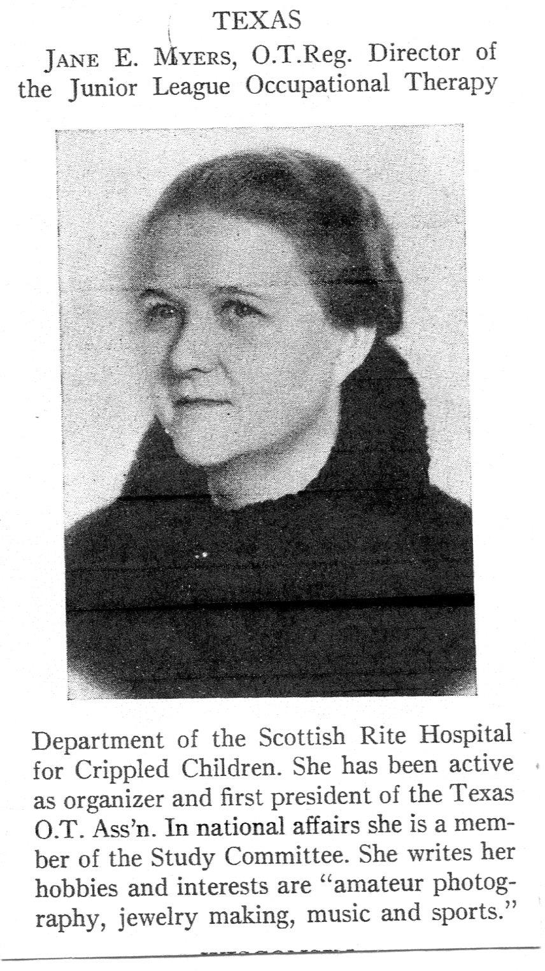
Personals (1937, Sept.). Texas: Jane E. Myers. Journal of Occupational Therapy (sample issue). p 41.

Slide 17
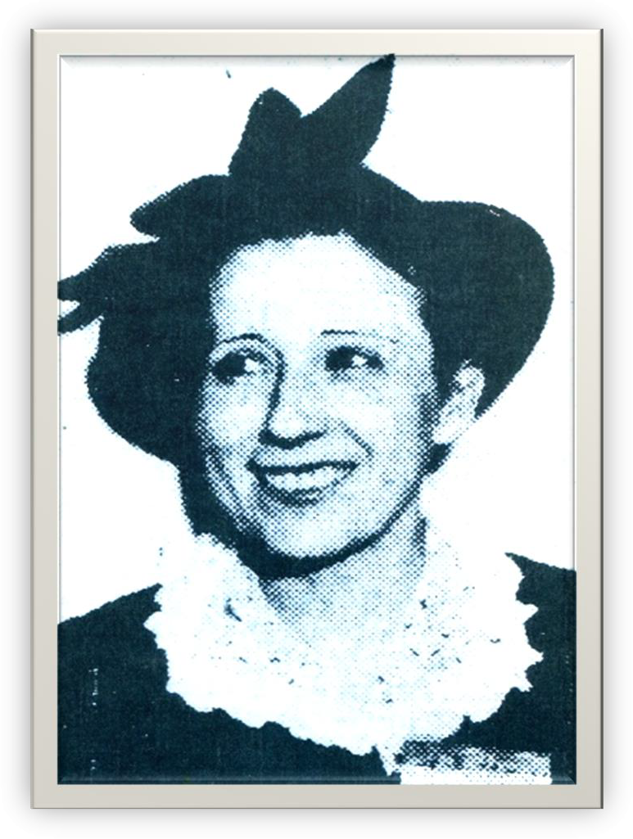
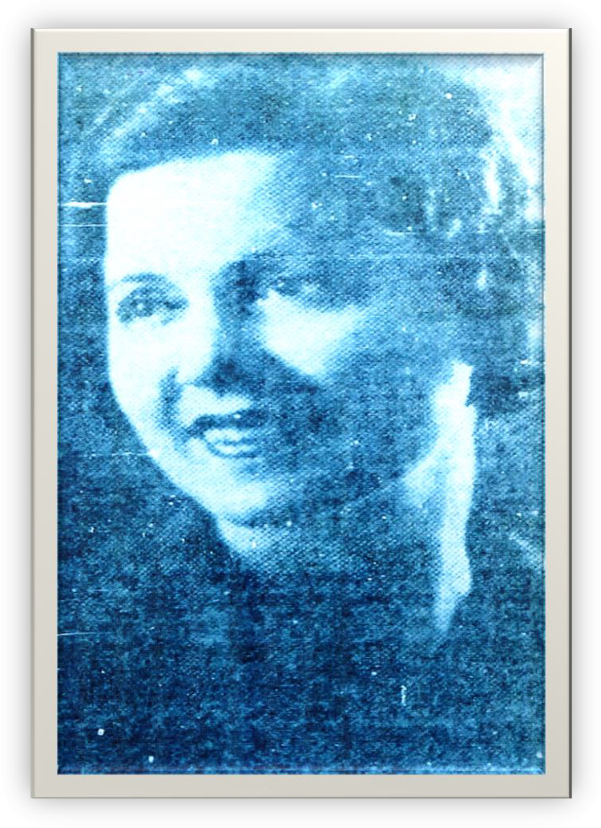
Vice President & Sec/Treas.
Margie Woodward
Olga Wheeler

Slide 18
Other Officers & Board Members
Marjorie Woodward – Mississippi/Louisiana School of OT – Eleanor Morse, director. Student of Eleanor Clarke Slagle
Olga Wheeler – Same
Pearl Jones Tennyson – Same
Dena L. Crausby – Same
Alice Eads – Southwest Texas Techers Normal College
Clyde McDowell Myres – craft teacher, Reconstruction Aide

Slide 19
Conferences
All meetings beginning in 1936 has presentations.
First identified conference brochure, 1952
Meetings/conferences have been held every year except war years (1942, 1943)
Early meetings/conferences were held with Texas Hospital Association
Early speakers were physicians or hospital directors. Gradually changed to OT presenters.

Slide 20
AOTA Representation
Jane Myers: first TOTA representative to AOTA House of Delegates (now Representative Assembly) and first to TOTA representative to serve on Board of Management (now Executive Board)
24 people have represented TOTA to AOTA (and counting)

Slide 21
AOTA Conferences in Texas
TOTA has hosted AOTA conferences as follows:
– 1953
– 1969
– 1981
– 1992
– 2009
– 2022
Houston Dallas
San Antonio Houston Houston San Antonio

Slide 22
Awards/Recognitions
Started in 1966 as an incentive to attend conference
First award: OTR of the Year (now OT of the Year)
Thirteen more award categories have followed: COTA/OTA of the Year, Clinical Educator of the Year, Clinical Excellence, Distinguished Service Award, Letter of Appreciation, Roster of Merit, Academic Educator of the Year, OTA/OT Collaboration Award, Interdisciplinary Team Award, Student Leadership Award, Horizon Award, Service Recognition Award, and Legislator of the Year

Slide 23
Incorporation
TOTA was incorporated in 1973
Objectives were:
Improve and advance the practice of occupational therapy
Improve and advance education and qualification for providers of occupational therapy
Foster research and study of occupational therapy
Engage in other activities to further dissemination of knowledge about occupational therapy

Slide 24
Districts
Districts were created to better service members at the local level
Originally 5 districts were created in 1974
Change to 6 current districts: Added Rio Grande
Alamo South
Capital Centex
Great Plains West
Gulf Coast East
Rio Grande (1993)
Trinity North

Slide 25
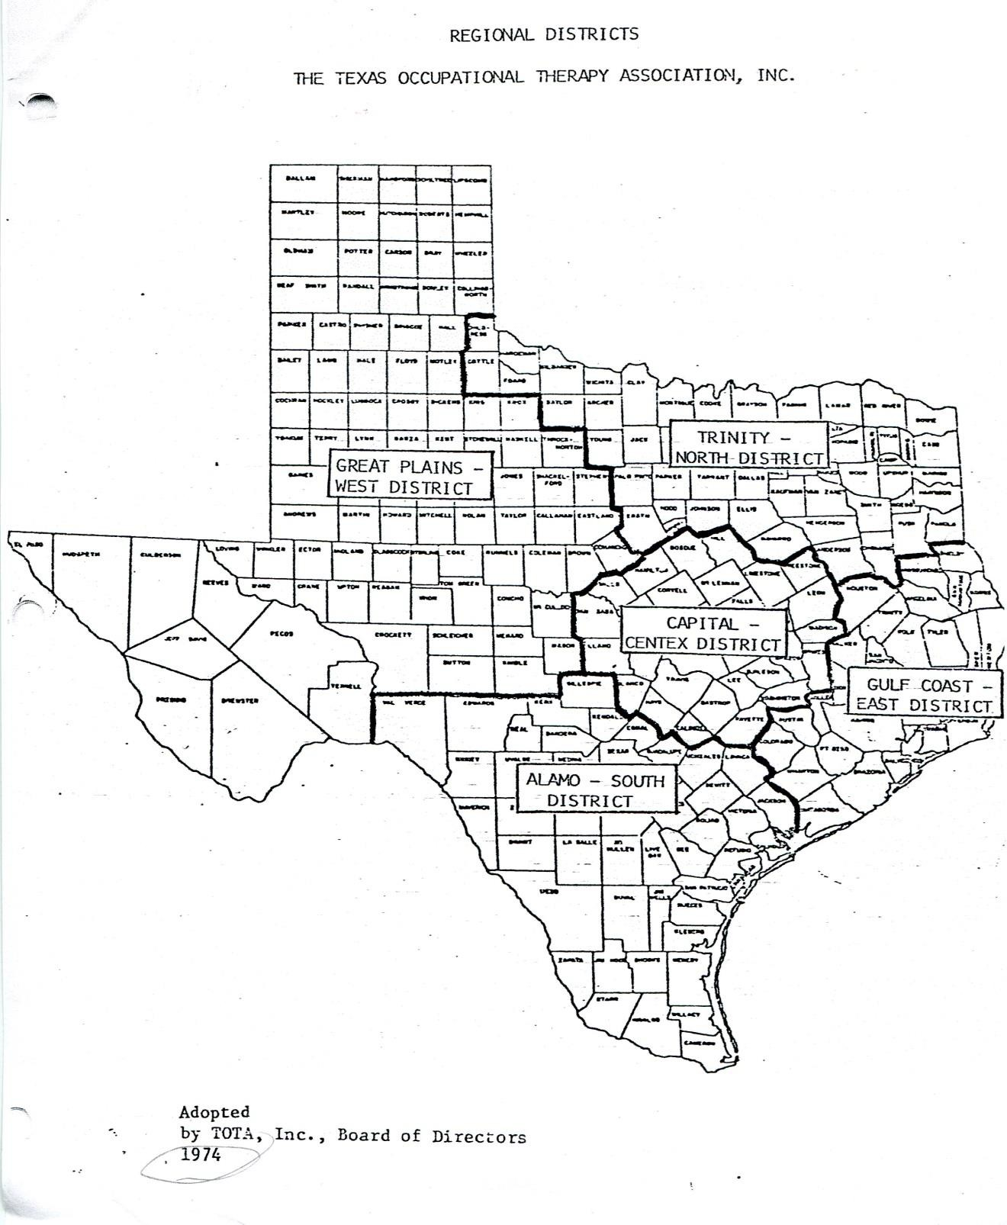

Slide 26
Licensure
1983. The Texas Legislature passed the bill to license occupational therapy personnel
Both OTs and OTAs were included.
Original board: TABOT (Texas Advisory Board of Occupational Therapy) (1983-1993)
Current board: TBOTE (Texas Board of Occupational Therapy Examiners) (1993- present)

Slide 27
Historical Archives
Historical documents of TOTA are housed at Moody Medical Library, University of Texas Medical Branch, Galveston.
First collection donated in 1990
A guide to the collection was created in 1992

Slide 28
Executive Directors
TOTA has had three executive directors
Augusta Gelfant (1995-2000)
Mary Hennigan (2000-2016)
Judith Joseph (2017-

Slide 29
Some Famous Texan OTs
Two Presidents of AOTA: Jerry Johnson, Robert Bing
Two Speakers of RA: Regina (Reggie) Campbell, Mary Francis (Francie) Baxter
One Vice President of AOTA: Charles (Chuck) Christensen
One VP of RA: Diane Puccetti
One Secretary of AOTA: Esther Bell
One Parliamentarian to the RA: Esther Bell
*and counting

Slide 30
References
American Occupational Therapy Association (1932-43) National Directory of Qualified Occupational Therapists. New York: Author
Occupational Therapy Notes: (1936). First meeting of Texas association, Occupational Therapy and Rehabilitation, 15(5)337- 338.
Bell, E. (2006). TOTA 1936-2006: In celebration of our 70th anniversary. Revista OT, Spring, pp. 1, 4-6.
Bell, E. (2006). From crafts to research. Revista OT, Conference
Issue, pp. 1, 5.
Gilekson, G. & Gilekson, G. (1996). The Texas Occupational Therapy
Association: The first 60 years…1936-1996. Austin, TX: TOTA
Low, J. (1985). Pearl Jones Tennyson. Chicago: University of Illinois
Archives Library. (transcription of notes)

Slide 31
This PowerPoint can be reproduced without permission for educational purposes. It is the property of TOTA

